Slide 1

RUNGTA COLLEGE OF DENTAL SCIENCES & RESEARCH
CHILD PSYCHOLOGY
DEPARTMENT OF PEDODONTICS AND PREVENTIVE DENTISTRY

Slide 2
Specific learning Objectives
Core areas | Domain
Introduction Definition Theories | Psychosocial aspects in orthodontic treatment. Orthodontic treatment for special care needs child.

Slide 3
CATEGORY
MUST TO KNOW
NICE TO KNOW
Classical conditioning
DESIRE TO KNOW
Social learning theory
Theories
Approaches in psychology
Operant conditioning
Hierarchy of needs

Slide 4
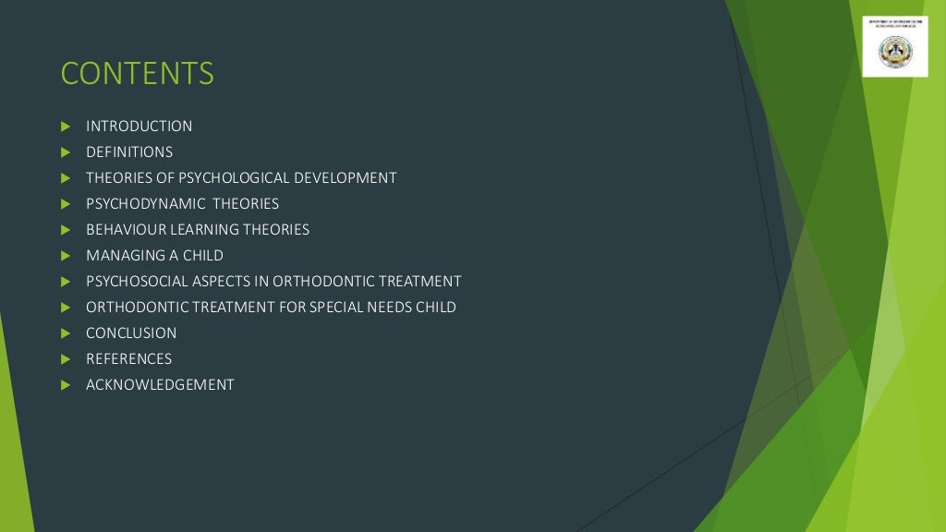

Slide 5
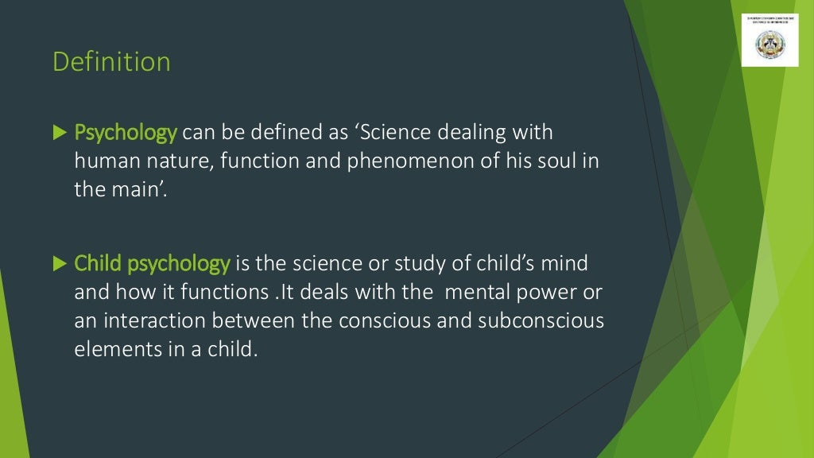

Slide 6
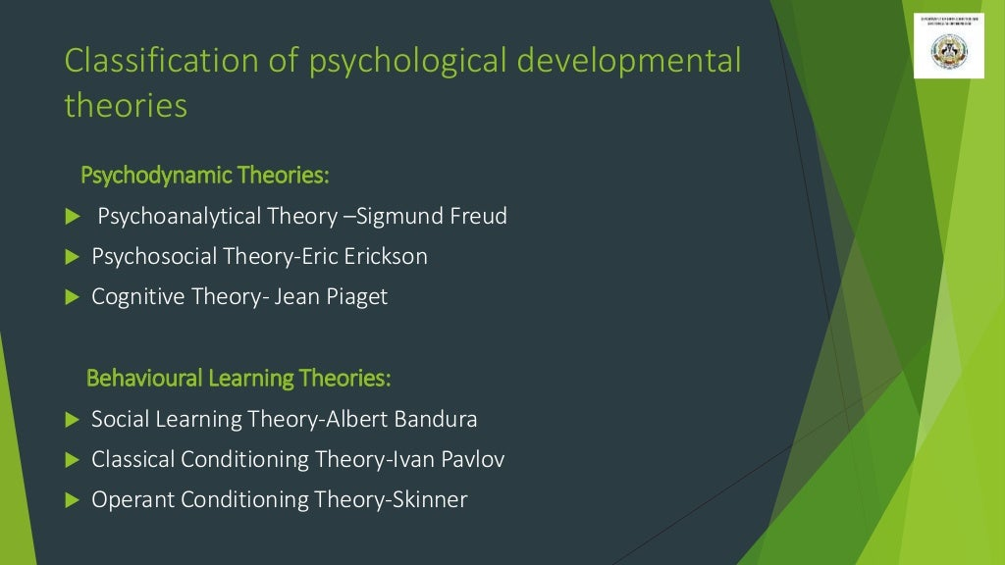

Slide 7
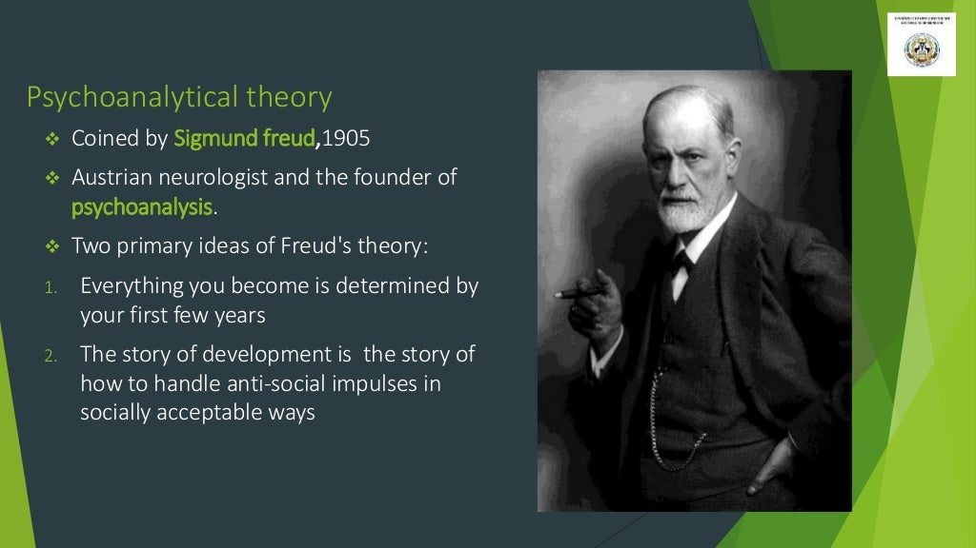

Slide 8
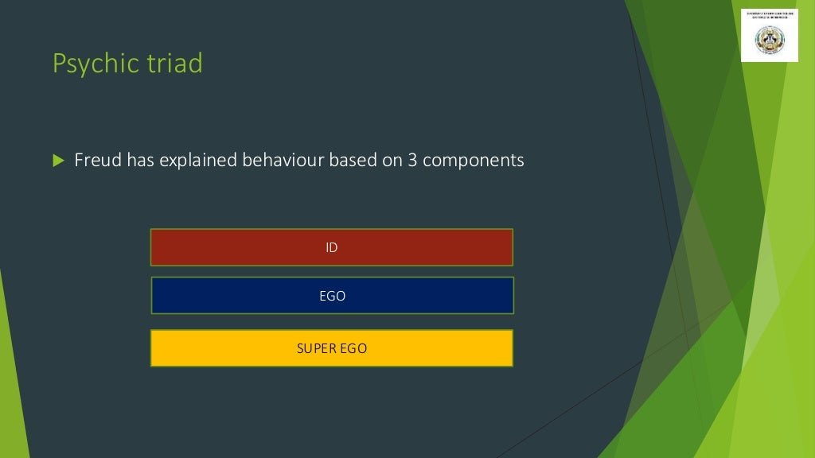

Slide 9
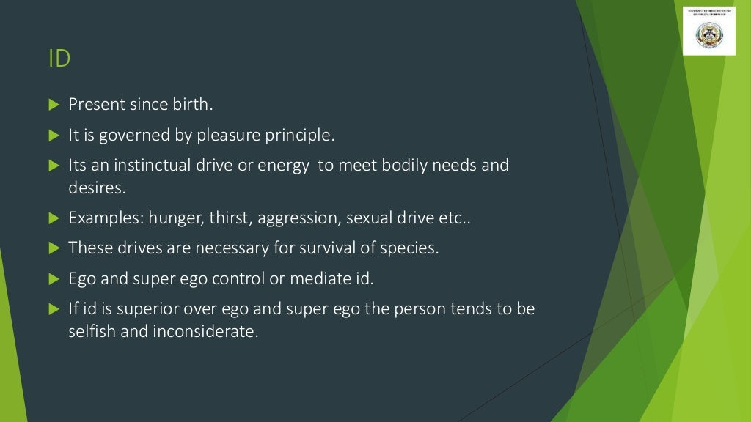

Slide 10
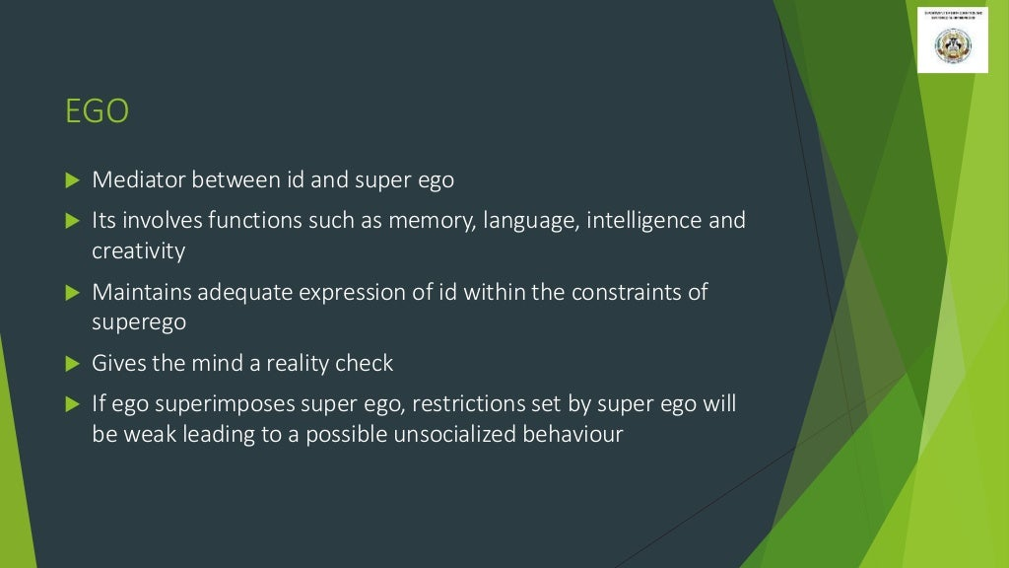

Slide 11
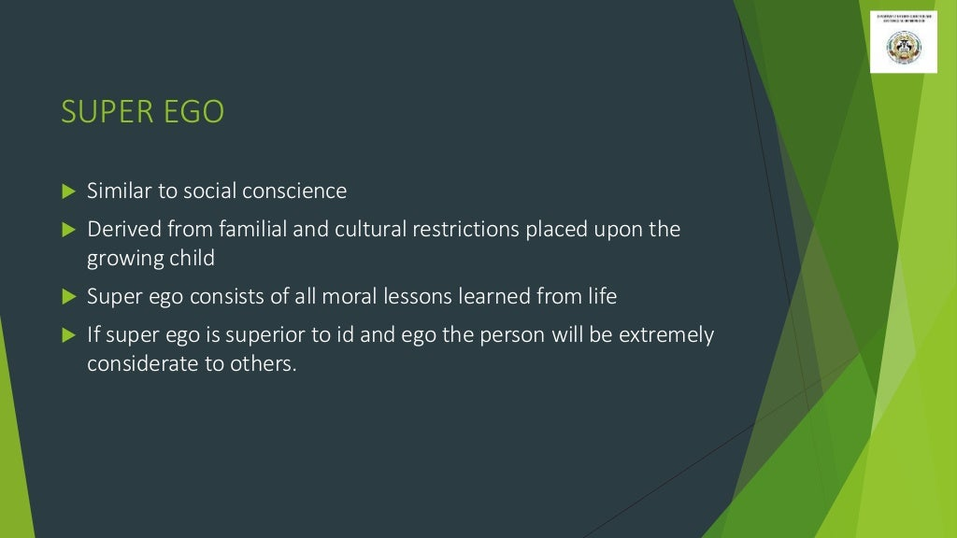

Slide 12
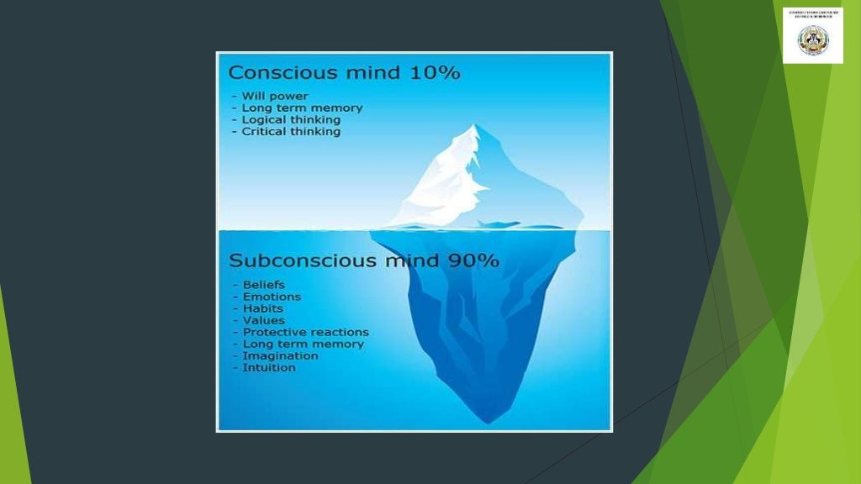

Slide 13
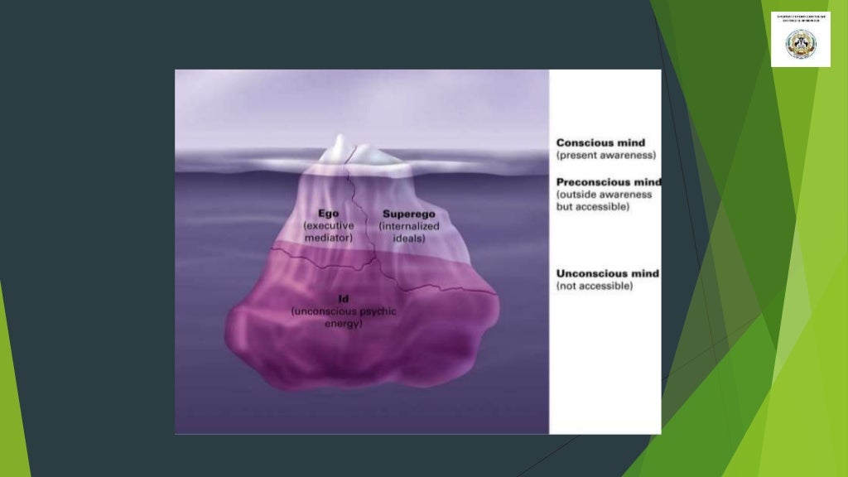

Slide 14
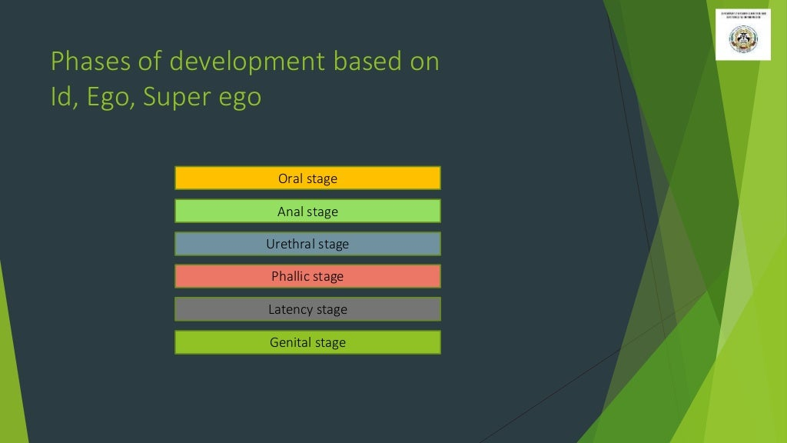

Slide 15
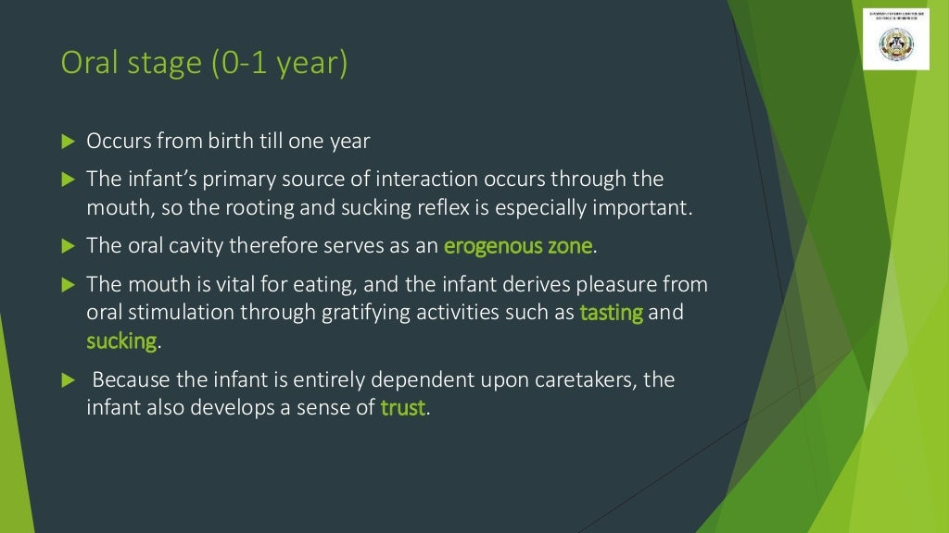

Slide 16
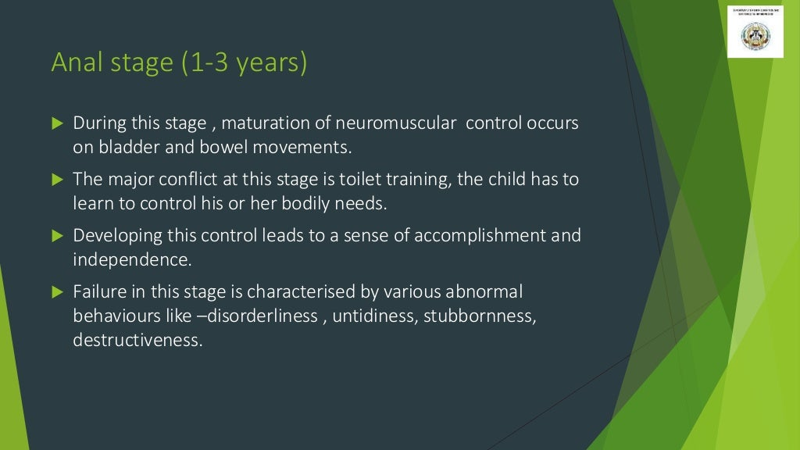

Slide 17
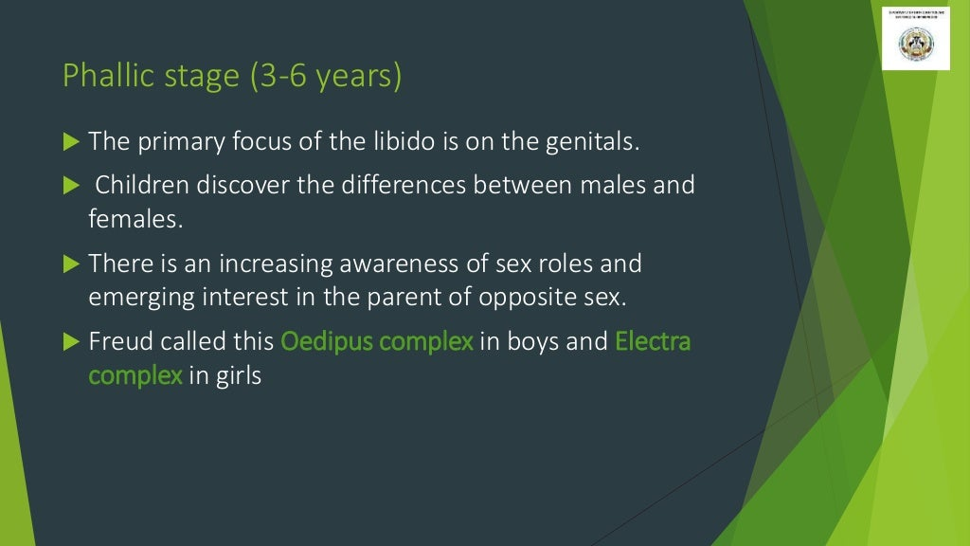

Slide 18
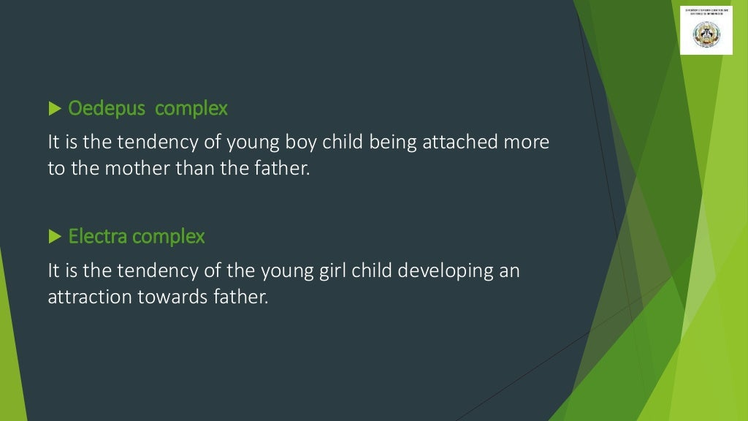

Slide 19
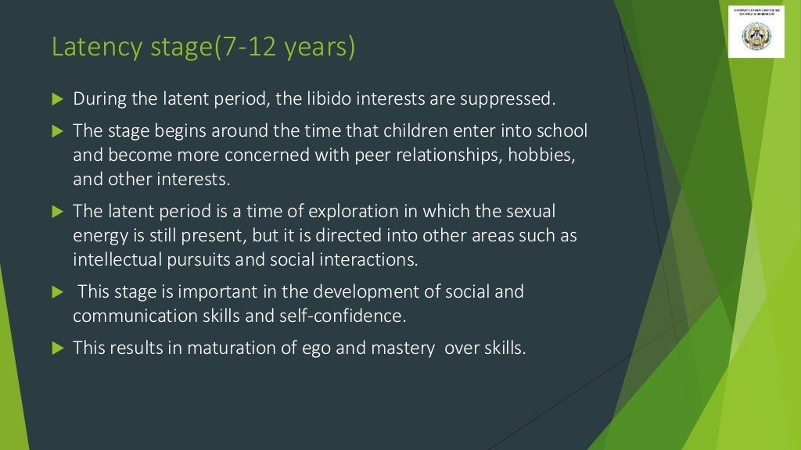

Slide 20
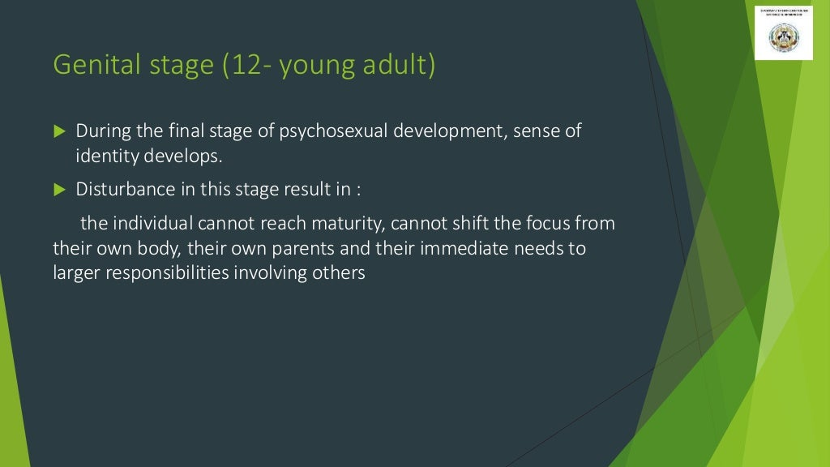

Slide 21
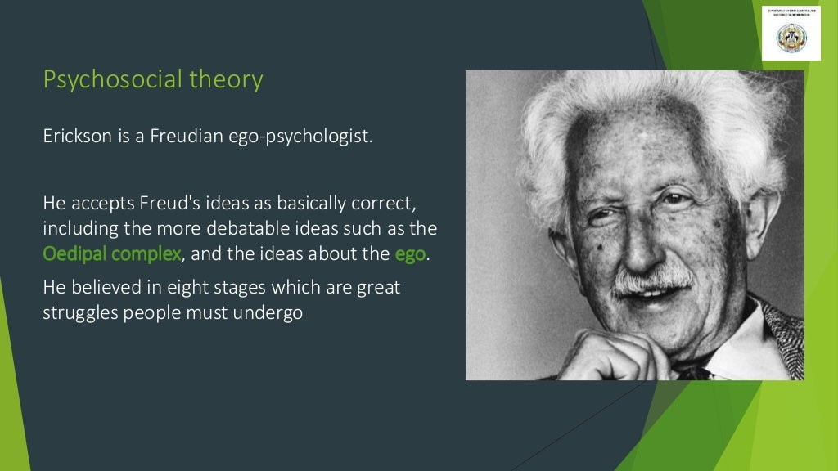

Slide 22
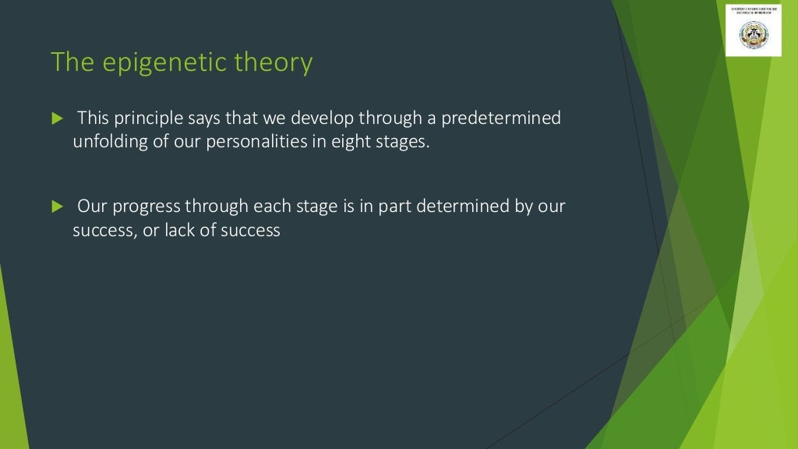

Slide 23
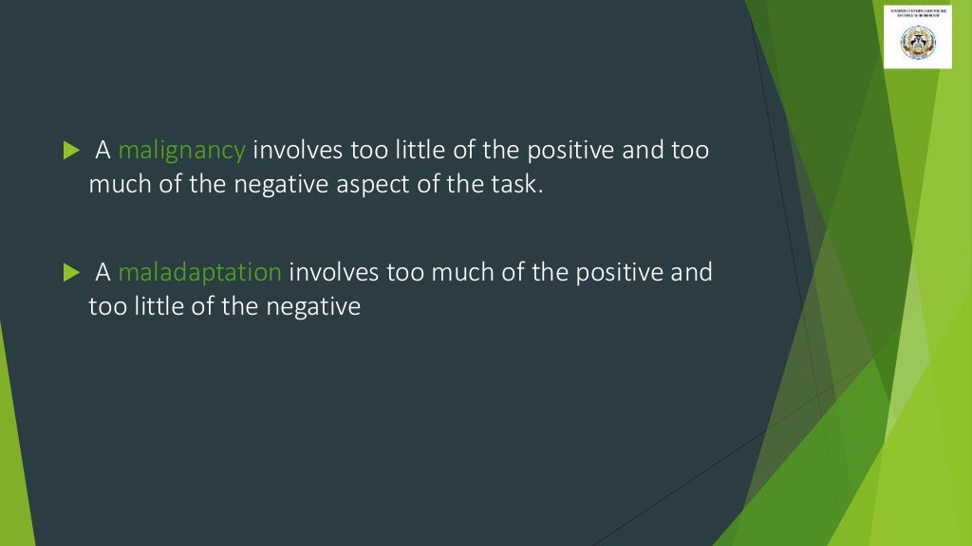

Slide 24
